Slide 1

Game Theory Eight
Stability of Numerically Modeling BNN with RK4
Jacob Wyngaard

Slide 2

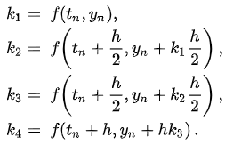

Runge – Kutta Fourth Order (RK4) Method
ODE
Four Increments
Update Values

Slide 3
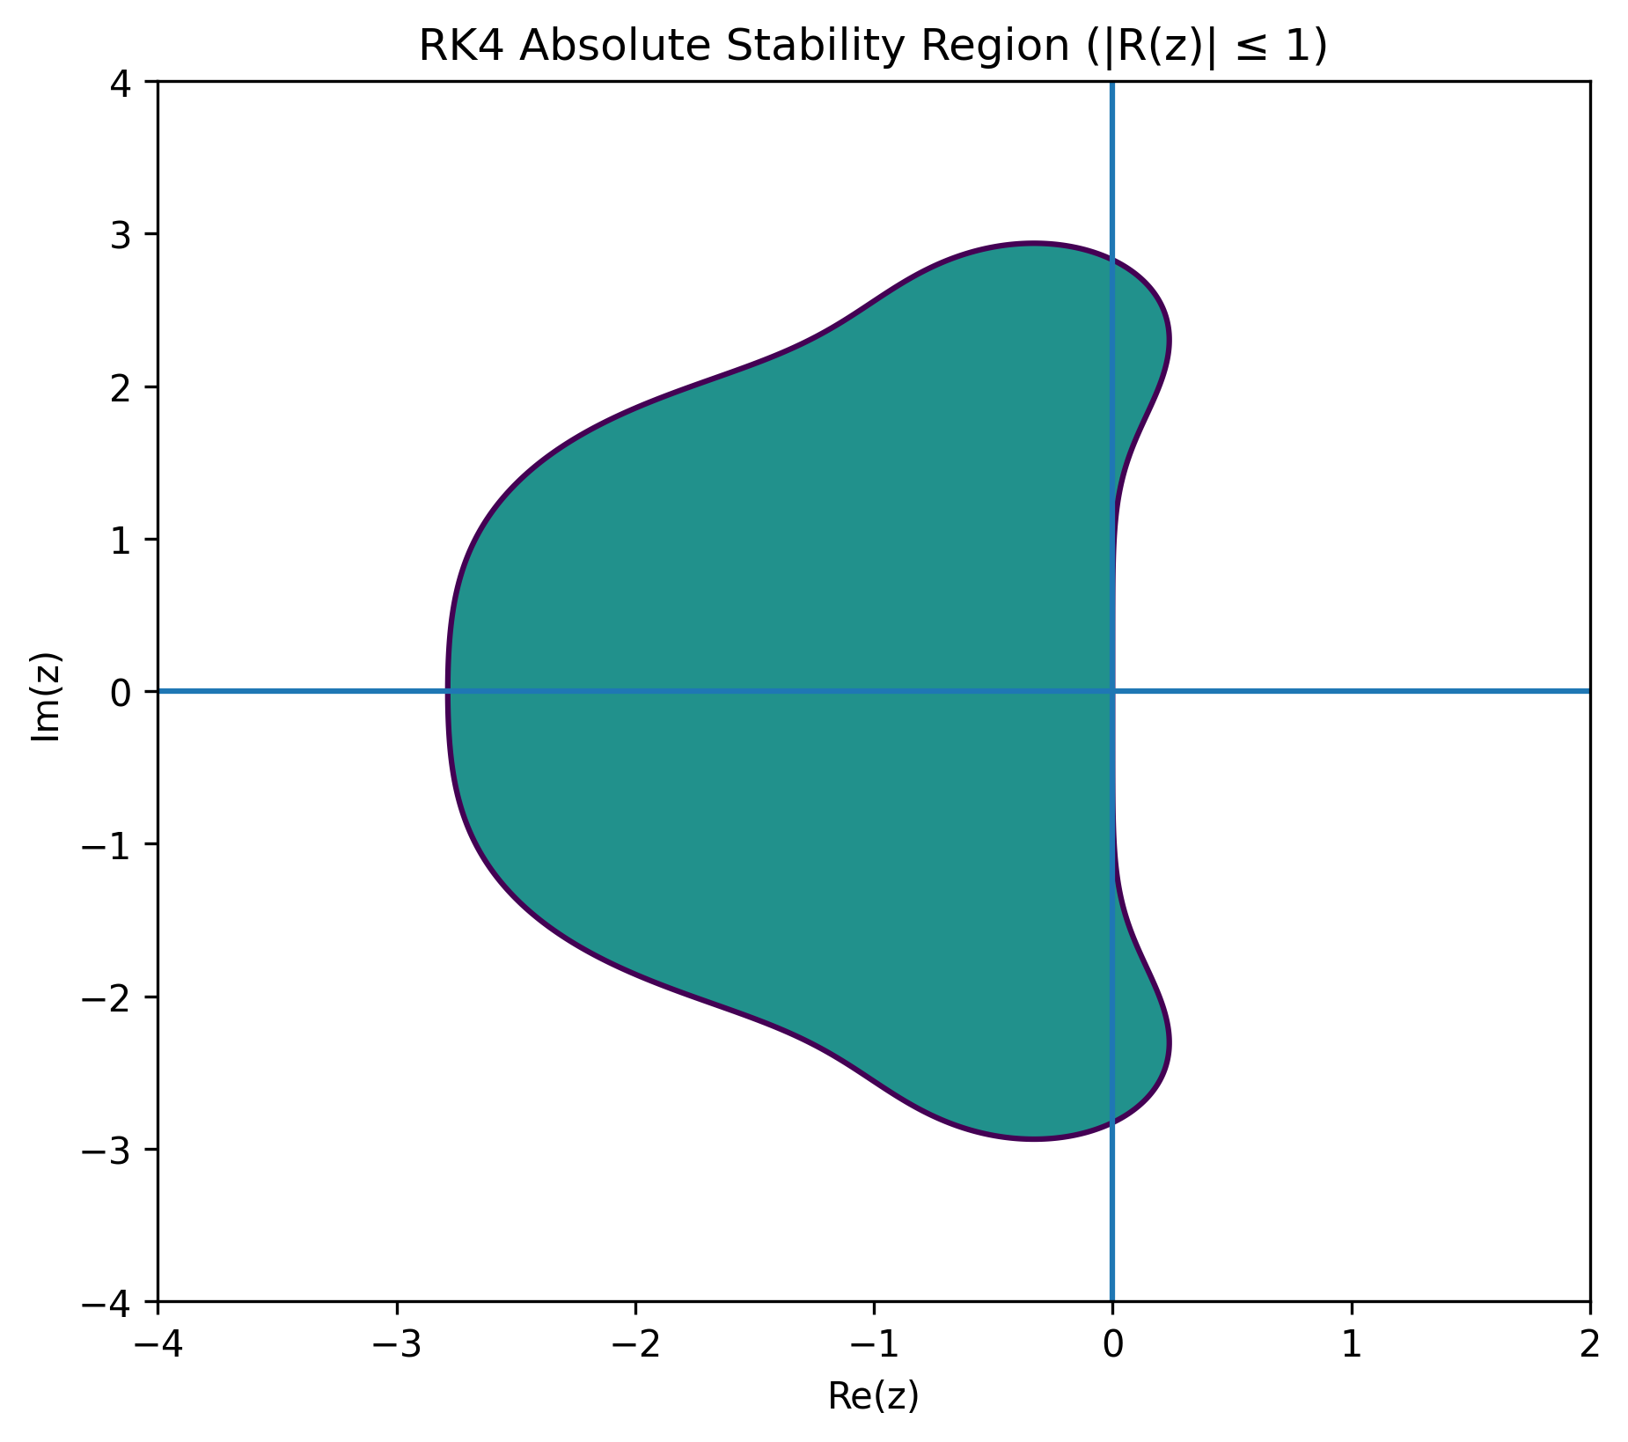
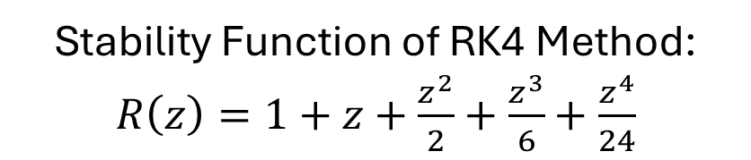
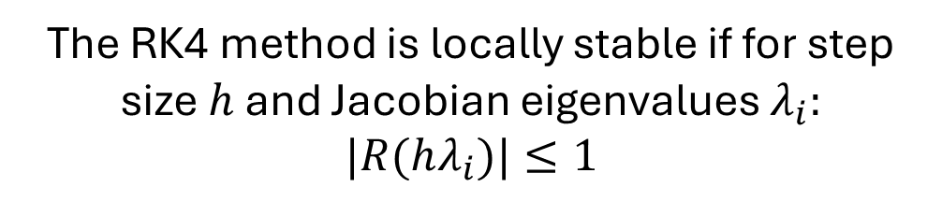
Stability of RK4 Method
The stability of the RK4 method for a system of ODEs depends on the Jacobian matrix of the ODE system and the stability function of the RK4 method
Stability Function of RK4 Method: $R\left(z\right)=1+z+\frac{z^{2}}{2}+\frac{z^{3}}{6}+\frac{z^{4}}{24}$
*These are the first four terms of the Taylor Series for $e^{z}$
The RK4 method is locally stable if for step size $h$ and Jacobian eigenvalues $λ_{i}:$
$|R(hλ_{i})|≤1$

Slide 4
Numerically Modeling Simple BNN System
Let’s start with the simplest version of a BNN system:
Two players each with two strategies, one of which strictly dominates the other
Player 1 Payoff Matrix
Player 2 Payoff Matrix
Player 2
Player 2
A
B
A
B
1
1 | 2
3 | 4
1
5 | 7
6 | 8
Player 1
Player 1
2
2
Player 1 Strategy:${ p}^{1}=(x^{1},y^{1})$ Player 2 Strategy:${ p}^{2}=(x^{2},y^{2})$

Slide 5
Numerically Modeling Simple BNN System
Player 1 Payoff Matrix
Player 2 Payoff Matrix
Player 2
Player 2
A
B
A
B
1
1 | 2
3 | 4
1
5 | 7
6 | 8
Player 1
Player 1
2
2
Player 1: Strategy 2 strictly dominates Strategy 1
Player 2: Strategy B strictly dominates Strategy A

Slide 6
Numerically Modeling Simple BNN System
A
B
A
B
1
1 | 2
3 | 4
1
5 | 7
6 | 8
2
2
Player 1 Strategy:${ p}^{1}=(x^{1},y^{1})$ Player 2 Strategy:${ p}^{2}=(x^{2},y^{2})$
$$φ_{11}\left(p\right)=max⁡(0, 1x^{2}+3y^{2}−(1x^{1}x^{2}+2x^{1}y^{2}+3y^{1}x^{2}+4y^{1}y^{2}))$$
$$φ_{12}\left(p\right)=max⁡(0, 3x^{2}+4y^{2}−(1x^{1}x^{2}+2x^{1}y^{2}+3y^{1}x^{2}+4y^{1}y^{2}))$$
$$φ_{2A}\left(p\right)=max⁡(0, {5x}^{1}+6y^{1}−(5x^{1}x^{2}+7x^{1}y^{2}+6y^{1}x^{2}+8y^{1}y^{2}))$$
$$φ_{2B}\left(p\right)=max⁡(0, 7x^{1}+8y^{1}−(5x^{1}x^{2}+7x^{1}y^{2}+6y^{1}x^{2}+8y^{1}y^{2}))$$

Slide 7

Numerically Modeling Simple BNN System
The strict dominance of Strategy 2 over Strategy 1 gives us that:
$$φ_{11}\left(p\right)=0$$
“There is no Player 2 strategy for which Player 1 wants to choose Strategy 1”
The strict dominance of Strategy B over Strategy A gives us that:
$$φ_{2A}\left(p\right)=0$$
“There is no Player 1 strategy for which Player 2 wants to choose Strategy A”
A
B
A
B
Player 1 Payoff Matrix
Player 2 Payoff Matrix
1
1 | 2
3 | 4
1
5 | 7
6 | 8
2
2

Slide 8
Numerically Modeling Simple BNN System
A
B
A
B
1
1 | 2
3 | 4
1
5 | 7
6 | 8
2
2
Player 1 Strategy:${ p}^{1}=(x^{1},y^{1})$ Player 2 Strategy:${ p}^{2}=(x^{2},y^{2})$
$$φ_{11}\left(p\right)=0$$
$$φ_{12}\left(p\right)=3x^{2}+4y^{2}−1x^{1}x^{2}−2x^{1}y^{2}−3y^{1}x^{2}−4y^{1}y^{2}$$
$$φ_{2A}\left(p\right)=0$$
$$φ_{2B}\left(p\right)=7x^{1}+8y^{1}−5x^{1}x^{2}−7x^{1}y^{2}−6y^{1}x^{2}−8y^{1}y^{2}$$

Slide 9

Numerically Modeling Simple BNN System
Using $3x^{2}+4y^{2}=3x^{2}\left(x^{1}+y^{1}\right)+4y^{2}\left(x^{1}+y^{1}\right)=3x^{1}x^{2}+3y^{1}x^{2}+4x^{1}y^{2}+4y^{1}y^{2}$
and
$$7x^{1}+8y^{1}=7x^{1}\left(x^{2}+y^{2}\right)+8y^{1}\left(x^{2}+y^{2}\right)=7x^{1}x^{2}+7x^{1}y^{2}+8y^{1}x^{2}+8y^{1}y^{2}$$
We get the following $φ_{ij}$ functions:
$$φ_{11}\left(p\right)=0$$
$$φ_{12}\left(p\right)=2x^{1}x^{2}+2x^{1}y^{2}=2x^{1}$$
$$φ_{2A}\left(p\right)=0$$
$$φ_{2B}\left(p\right)=2x^{1}x^{2}+2y^{1}x^{2}=2x^{2}$$

Slide 10

Numerically Modeling Simple BNN System
We use the $φ_{ij}$ functions to construct the dynamical system:
$${\dot{p}}_{ij}=φ_{ij}\left(p\right)−p_{ij}\sum_{k}{φ_{ik}\left(p\right)}$$
$$\dot{x^{1}}={y^{1}φ}_{11}\left(p\right)−x^{1}φ_{12}\left(p\right)$$
$$\dot{x^{1}}={y^{1}φ}_{11}\left(p\right)−x^{1}φ_{12}\left(p\right)$$
$$\dot{y^{1}}={x^{1}φ}_{12}\left(p\right)−y^{1}φ_{11}\left(p\right)$$
$$\dot{y^{1}}={x^{1}φ}_{12}\left(p\right)−y^{1}φ_{11}\left(p\right)$$
$$\dot{x^{2}}={y^{2}φ}_{2A}\left(p\right)−x^{2}φ_{2B}\left(p\right)$$
$$\dot{x^{2}}={y^{2}φ}_{2A}\left(p\right)−x^{2}φ_{2B}\left(p\right)$$
$$\dot{y^{2}}={x^{2}φ}_{2B}\left(p\right)−y^{2}φ_{2A}\left(p\right)$$
$$\dot{y^{2}}={x^{2}φ}_{2B}\left(p\right)−y^{2}φ_{2A}\left(p\right)$$
Note that $p=( \left(x^{1},y^{1}\right), \left(x^{2},y^{2}\right))$ contains the mixed strategy information of all players

Slide 11




Numerically Modeling Simple BNN System
We use the $φ_{ij}$ functions to construct the dynamical system:
$${\dot{p}}_{ij}=φ_{ij}\left(p\right)−p_{ij}\sum_{k}{φ_{ik}\left(p\right)}$$
$$\dot{x^{1}}=φ_{11}\left(p\right)−x^{1}(φ_{11}\left(p\right)+φ_{12}\left(p\right))$$
$$\dot{x^{1}}=−2({x^{1})}^{2}$$
$$\dot{y^{1}}=φ_{12}\left(p\right)−y^{1}(φ_{11}\left(p\right)+φ_{12}\left(p\right))$$
$$\dot{y^{1}}=2({x^{1})}^{2}$$
$$\dot{x^{2}}=φ_{2A}\left(p\right)−x^{2}(φ_{2A}\left(p\right)+φ_{2B}\left(p\right))$$
$$\dot{x^{2}}=−2({x^{2})}^{2}$$
$$\dot{y^{2}}=φ_{2B}\left(p\right)−y^{2}(φ_{2A}\left(p\right)+φ_{2B}\left(p\right))$$
$$\dot{y^{2}}=2({x^{2})}^{2}$$
Note that $p=( \left(x^{1},y^{1}\right), \left(x^{2},y^{2}\right))$ contains the mixed strategy information of all players

Slide 12
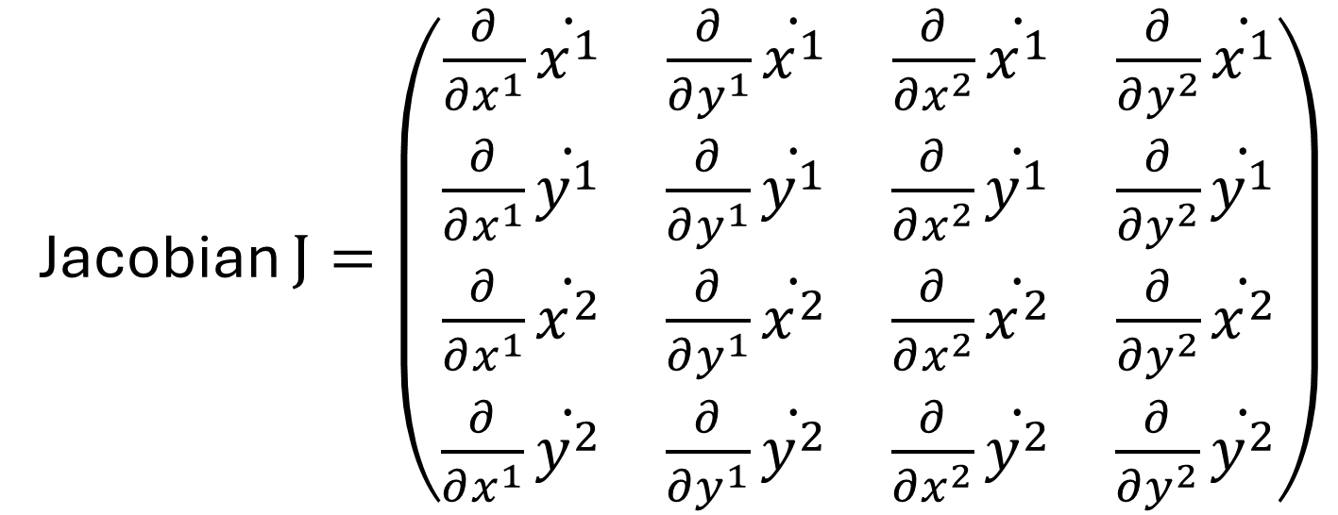
Numerically Modeling Simple BNN System
Jacobian $J=\left(\begin{matrix}\frac{∂}{∂x^{1}}\dot{x^{1}} & \frac{∂}{∂y^{1}}\dot{x^{1}} & \frac{∂}{∂x^{2}}\dot{x^{1}} & \frac{∂}{∂y^{2}}\dot{x^{1}} \\ \frac{∂}{∂x^{1}}\dot{y^{1}} & \frac{∂}{∂y^{1}}\dot{y^{1}} & \frac{∂}{∂x^{2}}\dot{y^{1}} & \frac{∂}{∂y^{2}}\dot{y^{1}} \\ \frac{∂}{∂x^{1}}\dot{x^{2}} & \frac{∂}{∂y^{1}}\dot{x^{2}} & \frac{∂}{∂x^{2}}\dot{x^{2}} & \frac{∂}{∂y^{2}}\dot{x^{2}} \\ \frac{∂}{∂x^{1}}\dot{y^{2}} & \frac{∂}{∂y^{1}}\dot{y^{2}} & \frac{∂}{∂x^{2}}\dot{y^{2}} & \frac{∂}{∂y^{2}}\dot{y^{2}}\end{matrix}\right)$
* For a two-player system where each player has two strategies

Slide 13
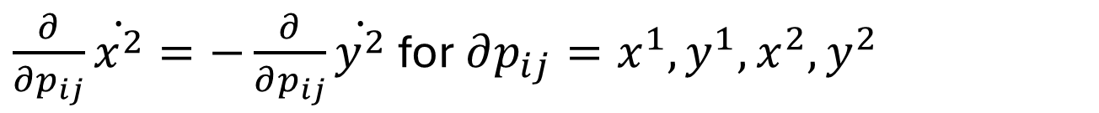
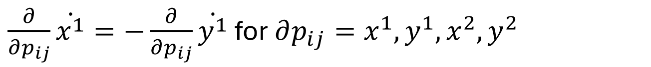
Numerically Modeling Simple BNN System
We can use the conservation of probability to generate symmetries within the Jacobian:
$$x^{1}+y^{1}=1 ⇒ \dot{x^{1}}+\dot{y^{1}}=0⇒\dot{x^{1}}=−\dot{y^{1}}$$
$\frac{∂}{∂p_{ij}}\dot{x^{1}}=−\frac{∂}{∂p_{ij}}\dot{y^{1}}$ for $∂p_{ij}=x^{1},y^{1},x^{2},y^{2}$
$$x^{2}+y^{2}=1 ⇒ \dot{x^{2}}+\dot{y^{2}}=0⇒\dot{x^{2}}=−\dot{y^{2}}$$
$\frac{∂}{∂p_{ij}}\dot{x^{2}}=−\frac{∂}{∂p_{ij}}\dot{y^{2}}$ for $∂p_{ij}=x^{1},y^{1},x^{2},y^{2}$

Slide 14
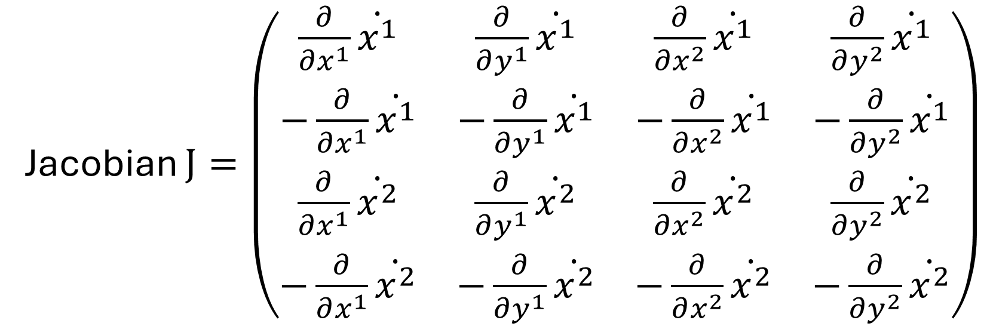
Numerically Modeling Simple BNN System
This modifies our Jacobian to:
Jacobian $J=\left(\begin{matrix}\frac{∂}{∂x^{1}}\dot{x^{1}} & \frac{∂}{∂y^{1}}\dot{x^{1}} & \frac{∂}{∂x^{2}}\dot{x^{1}} & \frac{∂}{∂y^{2}}\dot{x^{1}} \\ −\frac{∂}{∂x^{1}}\dot{x^{1}} & −\frac{∂}{∂y^{1}}\dot{x^{1}} & −\frac{∂}{∂x^{2}}\dot{x^{1}} & −\frac{∂}{∂y^{2}}\dot{x^{1}} \\ \frac{∂}{∂x^{1}}\dot{x^{2}} & \frac{∂}{∂y^{1}}\dot{x^{2}} & \frac{∂}{∂x^{2}}\dot{x^{2}} & \frac{∂}{∂y^{2}}\dot{x^{2}} \\ −\frac{∂}{∂x^{1}}\dot{x^{2}} & −\frac{∂}{∂y^{1}}\dot{x^{2}} & −\frac{∂}{∂x^{2}}\dot{x^{2}} & −\frac{∂}{∂y^{2}}\dot{x^{2}}\end{matrix}\right)$

Slide 15
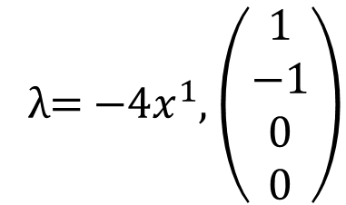
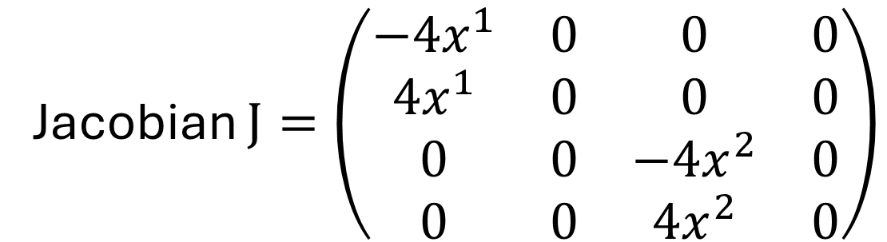
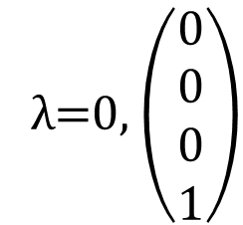
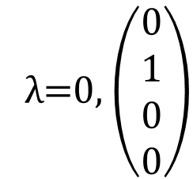


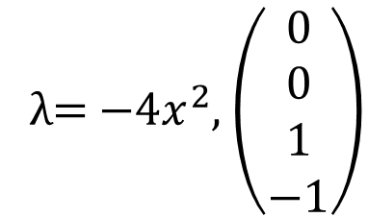
Numerically Modeling Simple BNN System
For our system:
$$\dot{x^{1}}=−2({x^{1})}^{2},$$
$$\dot{x^{2}}=−2({x^{2})}^{2}$$
Jacobian $J=\left(\begin{matrix}−4x^{1} & 0 & 0 & 0 \\ 4x^{1} & 0 & 0 & 0 \\ 0 & 0 & {−4x}^{2} & 0 \\ 0 & 0 & {4x}^{2} & 0\end{matrix}\right)$
Eigensystem
λ=0, $\left(\begin{matrix}0 \\ 1 \\ 0 \\ 0\end{matrix}\right)$
λ=0, $\left(\begin{matrix}0 \\ 0 \\ 0 \\ 1\end{matrix}\right)$
λ= $−4x^{1}$, $\left(\begin{matrix}1 \\ −1 \\ 0 \\ 0\end{matrix}\right)$
λ= $−{4x}^{2}$, $\left(\begin{matrix}0 \\ 0 \\ 1 \\ −1\end{matrix}\right)$

Slide 16
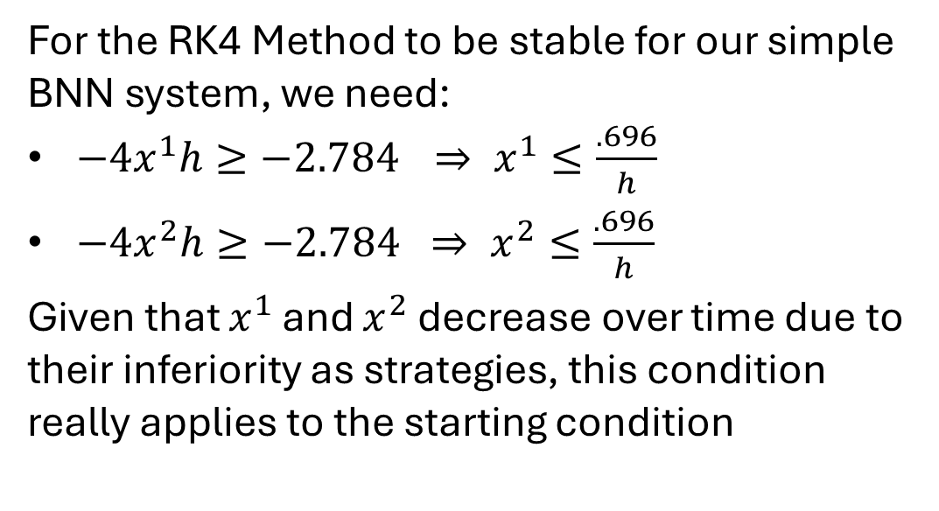
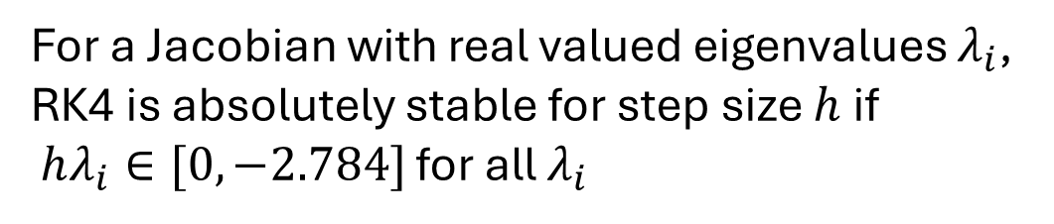
Numerically Modeling Simple BNN System
For a Jacobian with real valued eigenvalues $λ_{i}$, RK4 is absolutely stable for step size $h$ if
$hλ_{i}∈[0,−2.784]$ for all $λ_{i}$
For the RK4 Method to be stable for our simple BNN system, we need:
$−4x^{1}h≥−2.784$ $⇒ x^{1}≤\frac{.696}{h}$
$−4x^{2}h≥−2.784 ⇒ x^{2}≤\frac{.696}{h}$
Given that $x^{1}$ and $x^{2}$ decrease over time due to their inferiority as strategies, this condition really applies to the starting condition

Slide 17
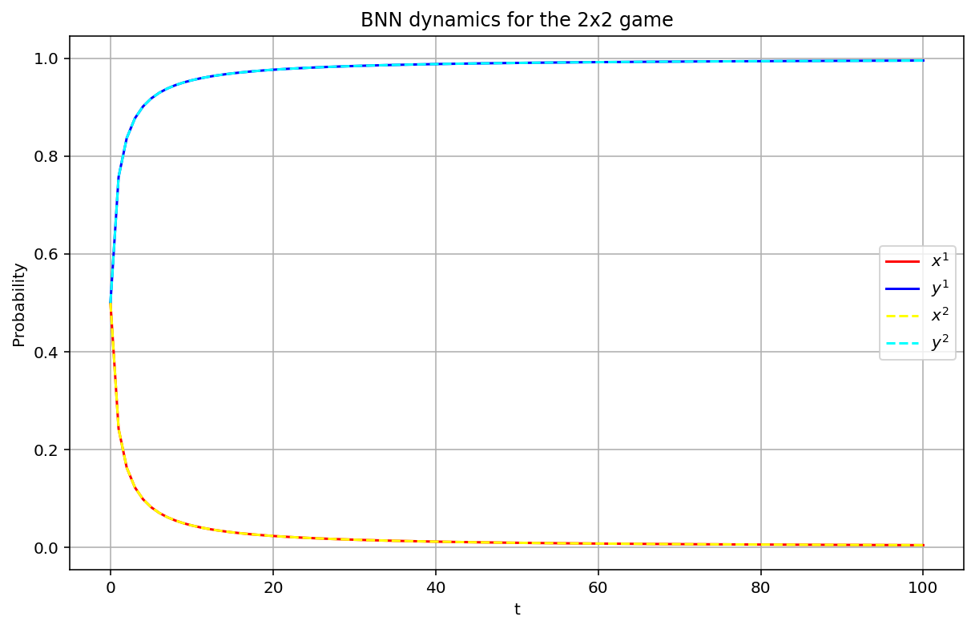





Numerical Results
$$h=1$$
Starting Conditions:
$$x^{1}=.5, x^{2}=.5$$
Stability Conditions:
$${−4x}^{1}h=−2≥−2.784$$
$${−4x}^{2}h=−2≥−2.784$$

Slide 18
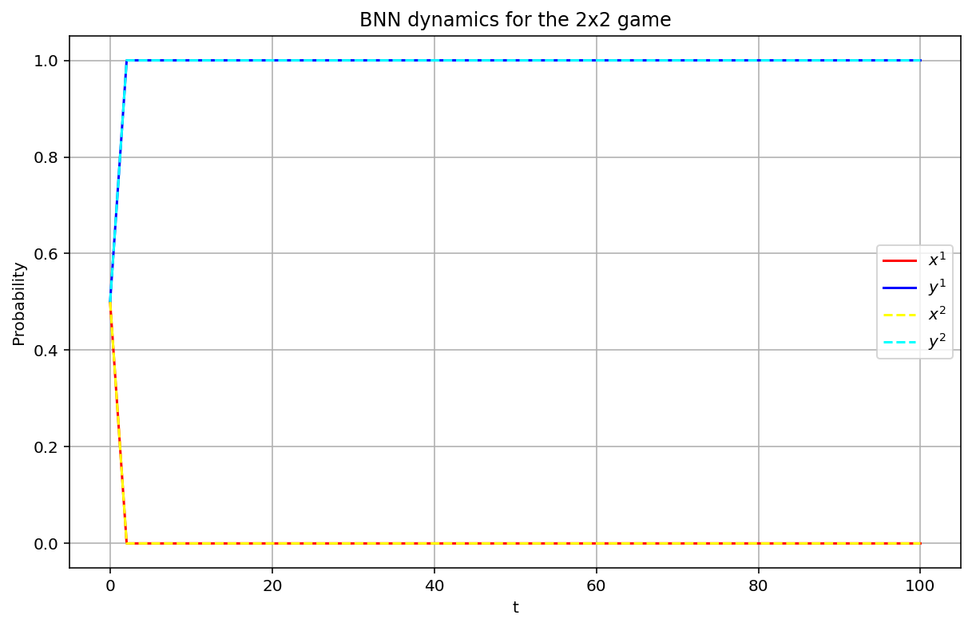




Numerical Results
$$h=2$$
Starting Conditions:
$$x^{1}=.5, x^{2}=.5$$
Stability Conditions:
$${−4x}^{1}h=−4<−2.784$$
$${−4x}^{2}h=−4<−2.784$$

Slide 19
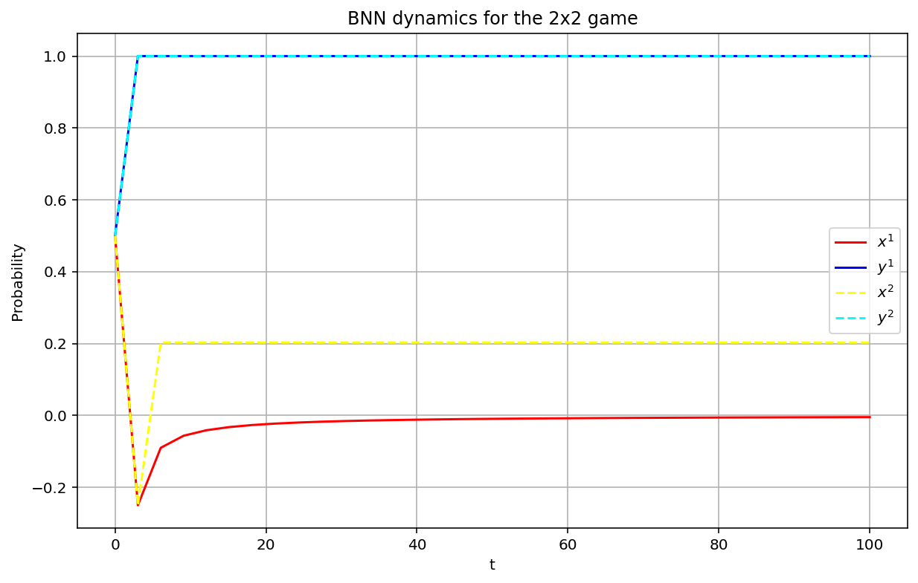



Numerical Results
$$h=3$$
Starting Conditions:
$$x^{1}=.5, x^{2}=.5$$
Stability Conditions:
$${−4x}^{1}h=−6<−2.784$$
$${−4x}^{2}h=−6<−2.784$$

Slide 20
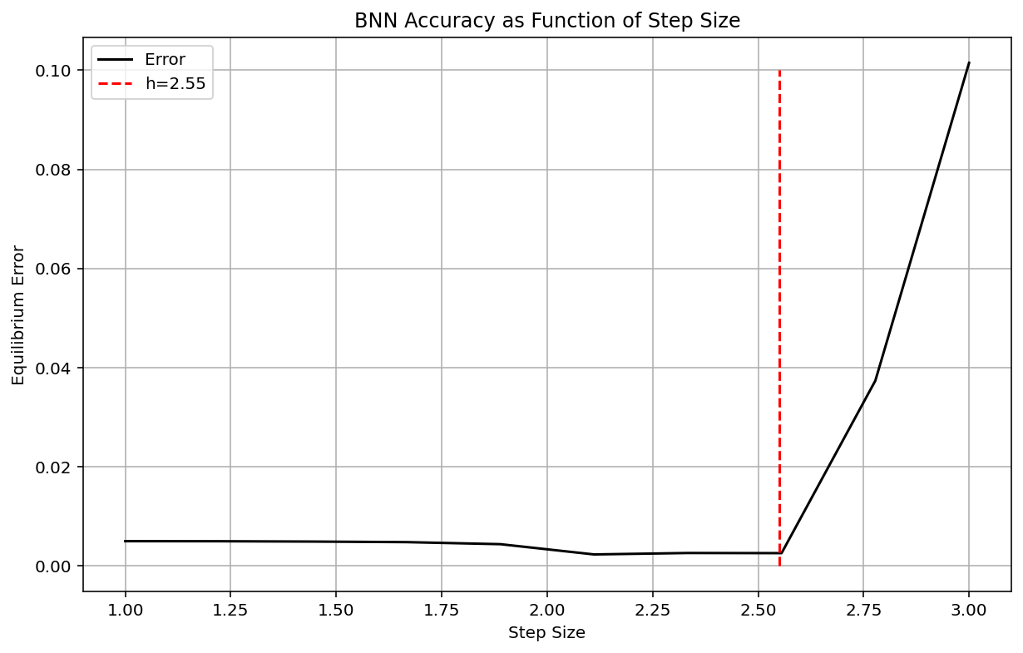

Numerical Results
RK4 Method
Starting Conditions:
$$x^{1}=.5, x^{2}=.5$$

Slide 21
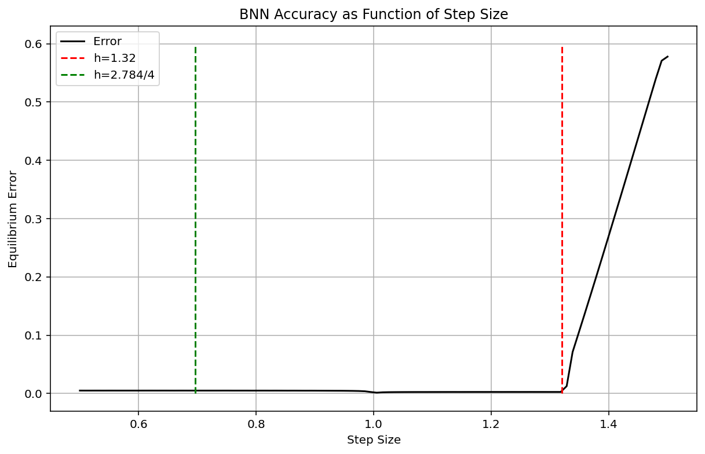

Numerical Results
RK4 Method
Starting Conditions:
$$x^{1}=1, x^{2}=1$$

Slide 22
Numerically Modeling More Complicated BNN System
Let’s start with a more interesting BNN system:
Two players each with two strategies, only one of which has a strictly dominant strategy
Player 1 Payoff Matrix
Player 2 Payoff Matrix
Player 2
Player 2
A
B
A
B
1
1 | 2
3 | 4
1
7 | 5
6 | 8
Player 1
Player 1
2
2
Player 1 Strategy:${ p}^{1}=(x^{1},y^{1})$ Player 2 Strategy:${ p}^{2}=(x^{2},y^{2})$

Slide 23
Numerically Modeling More Complicated BNN System
Player 1 Payoff Matrix
Player 2 Payoff Matrix
Player 2
Player 2
A
B
A
B
1
1 | 2
3 | 4
1
7 | 5
6 | 8
Player 1
Player 1
2
2
Player 1: Strategy 2 strictly dominates Strategy 1
Player 2: No strictly dominant strategy

Slide 24
Numerically Modeling More Complicated BNN System
A
B
1
7 | 5
6 | 8
2
Player 2 Payoff Matrix
$$φ_{2A}\left(p\right)=max⁡(0,7x^{1}+6y^{1}−7x^{1}x^{2}−5x^{1}y^{2}−6y^{1}x^{2}−8y^{1}y^{2})$$
$$φ_{2B}\left(p\right)=max⁡(0,5x^{1}+8y^{1}−7x^{1}x^{2}−5x^{1}y^{2}−6y^{1}x^{2}−8y^{1}y^{2})$$
$$φ_{2A}\left(p\right)=\max\left(0, 2x^{1}y^{2}−2y^{1}y^{2}\right)=2y^{2}max⁡(0,x^{1}−y^{1})$$
$$φ_{2B}\left(p\right)=\max\left(0, −2x^{1}x^{2}+2y^{1}x^{2}\right)=2x^{2}max⁡(0,y^{1}−x^{1})$$

Slide 25


Numerically Modeling More Complicated BNN System
We use the $φ_{ij}$ functions to construct the dynamical system:
$${\dot{p}}_{ij}=φ_{ij}\left(p\right)−p_{ij}\sum_{k}{φ_{ik}\left(p\right)}$$
$$\dot{x^{1}}={y^{1}φ}_{11}\left(p\right)−x^{1}φ_{12}\left(p\right)$$
$$\dot{x^{1}}=−2({x^{1})}^{2}$$
$$\dot{y^{1}}={x^{1}φ}_{12}\left(p\right)−y^{1}φ_{11}\left(p\right)$$
$$\dot{y^{1}}=2({x^{1})}^{2}$$
$$\dot{x^{2}}={y^{2}φ}_{2A}\left(p\right)−x^{2}φ_{2B}\left(p\right)$$
$$\dot{x^{2}}=2{(y^{2})}^{2}\max\left(0,x^{1}−y^{1}\right)−{2(x^{2})}^{2}max⁡(0,y^{1}−x^{1})$$
$$\dot{y^{2}}={x^{2}φ}_{2B}\left(p\right)−y^{2}φ_{2A}\left(p\right)$$
$$\dot{y^{2}}={2(x^{2})}^{2}max⁡(0,y^{1}−x^{1})−2{(y^{2})}^{2}\max\left(0,x^{1}−y^{1}\right)$$
Note that $p=( \left(x^{1},y^{1}\right), \left(x^{2},y^{2}\right))$ contains the mixed strategy information of all players

Slide 26


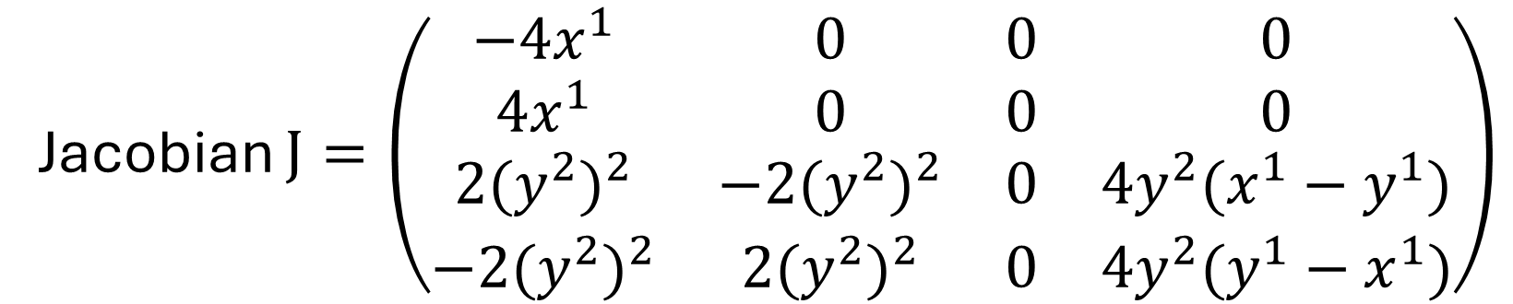


$x^{1}>y^{1}$case of $\dot{x^{2}}$ and $\dot{y^{2}}$
$$\dot{x^{2}}=2{(y^{2})}^{2}(x^{1}−y^{1})$$
$$\dot{y^{2}}=−{2(y^{2})}^{2}(x^{1}−y^{1})$$
Jacobian $J=\left(\begin{matrix}−4x^{1} & 0 & 0 & 0 \\ 4x^{1} & 0 & 0 & 0 \\ 2{(y^{2})}^{2} & −2{(y^{2})}^{2} & 0 & {4y}^{2}(x^{1}−y^{1}) \\ −2{(y^{2})}^{2} & 2{(y^{2})}^{2} & 0 & {4y}^{2}(y^{1}−x^{1})\end{matrix}\right)$
Eigenvalues
$$0,0,−4x^{1},−{4y}^{2}(x^{1}−y^{1})$$

Slide 27

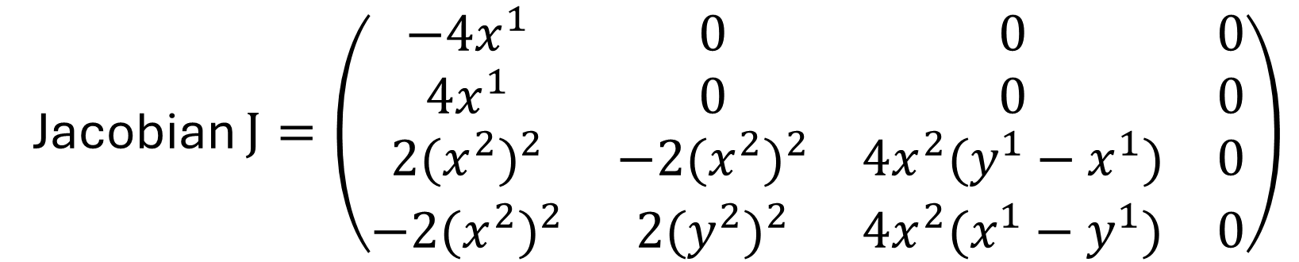



$y^{1}>x^{1}$case of $\dot{x^{2}}$ and $\dot{y^{2}}$
$$\dot{x^{2}}=−2{\left(x^{2}\right)}^{2}(y^{1}−x^{1})$$
$$\dot{y^{2}}={2(x^{2})}^{2}({y^{1}−x}^{1})$$
Jacobian $J=\left(\begin{matrix}−4x^{1} & 0 & 0 & 0 \\ 4x^{1} & 0 & 0 & 0 \\ 2{(x^{2})}^{2} & −2{(x^{2})}^{2} & {4x}^{2}(y^{1}−x^{1}) & 0 \\ −2{(x^{2})}^{2} & 2{(y^{2})}^{2} & {4x}^{2}(x^{1}−y^{1}) & 0\end{matrix}\right)$
Eigenvalues
$$0,0,−4x^{1},−{4x}^{2}(y^{1}−x^{1})$$

Slide 28
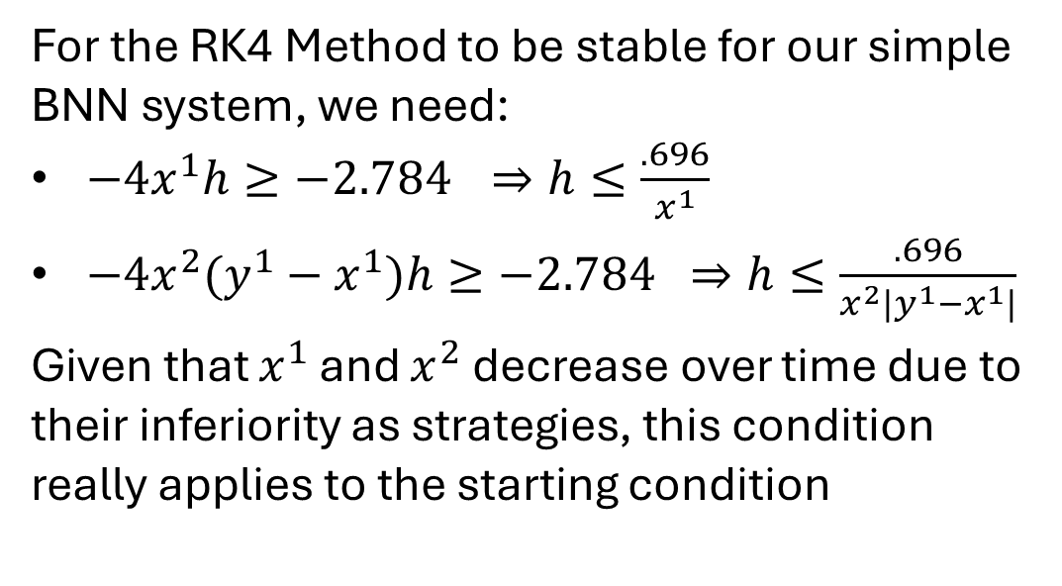
Numerically Modeling More Complicated BNN System
For a Jacobian with real valued eigenvalues $λ_{i}$, RK4 is absolutely stable for step size $h$ if
$hλ_{i}∈[0,−2.784]$ for all $λ_{i}$
For the RK4 Method to be stable for our simple BNN system, we need:
$−4x^{1}h≥−2.784$ $⇒h≤\frac{.696}{x^{1}}$
$−{4x}^{2}(y^{1}−x^{1})h≥−2.784 ⇒h≤\frac{.696}{x^{2}|y^{1}−x^{1}|}$
Given that $x^{1}$ and $x^{2}$ decrease over time due to their inferiority as strategies, this condition really applies to the starting condition

Slide 29
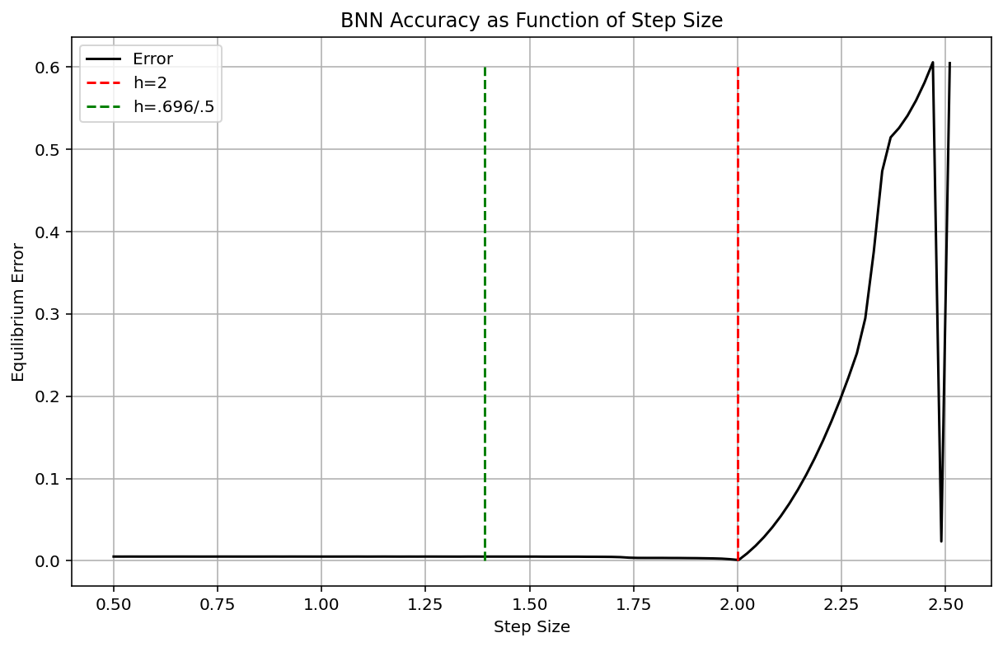
Numerical Results
RK4 Method
Starting Conditions:
$$x^{1}=.5, x^{2}=.5$$

Slide 30
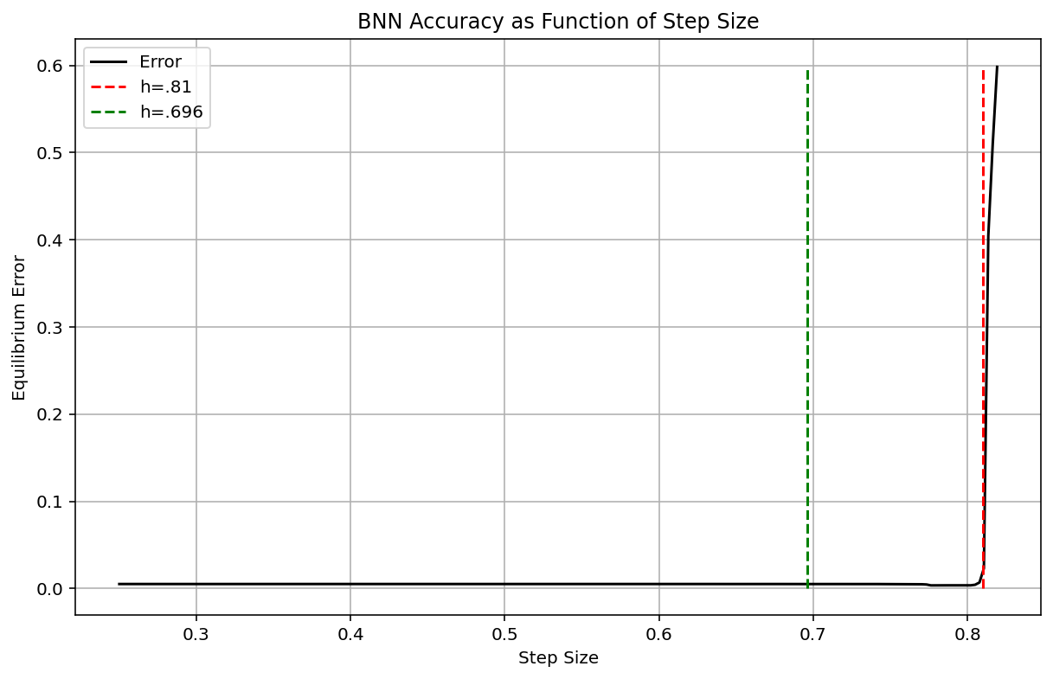
Numerical Results
RK4 Method
Starting Conditions:
$$x^{1}=1, x^{2}=1$$

Slide 31

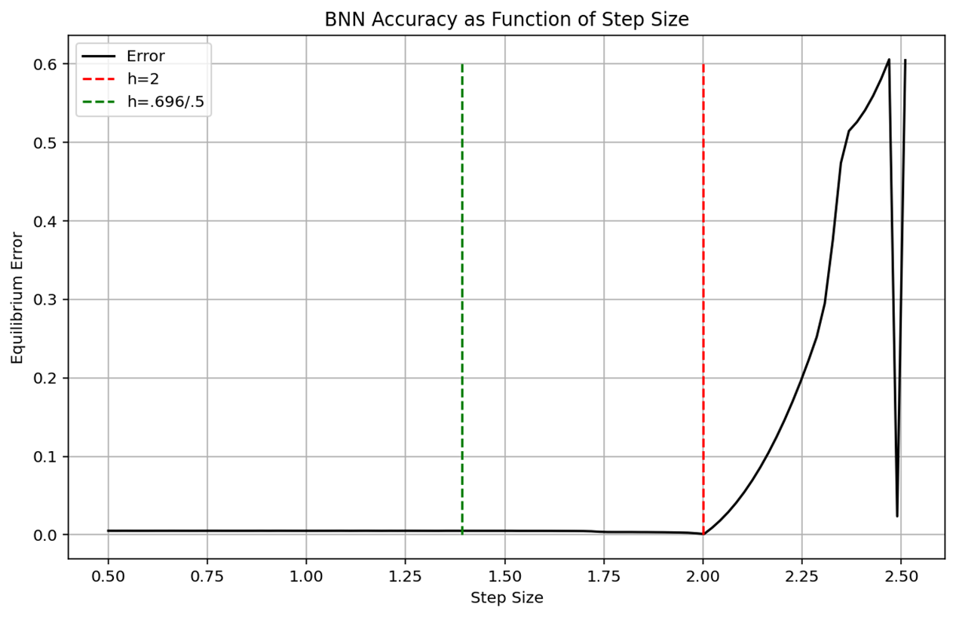

Numerical Results
Effects of Strict Dominance
Two Strictly Dominant Strategies
One Strictly Dominant Strategy
$$x^{1}=\frac{1}{2}, { x}^{2}=\frac{1}{2}$$
RK4 Method
Starting Conditions:

Slide 32
Numerically Modeling More Complicated BNN System
Let’s do an even more interesting BNN system:
Two players each with two strategies, neither with a strictly dominant strategy
Player 1 Payoff Matrix
Player 2 Payoff Matrix
Player 2
Player 2
A
B
A
B
1
2 | 3
4 | 1
1
7 | 5
6 | 8
Player 1
Player 1
2
2
Player 1 Strategy:${ p}^{1}=(x^{1},y^{1})$ Player 2 Strategy:${ p}^{2}=(x^{2},y^{2})$

Slide 33
Numerically Modeling More Complicated BNN System
A
B
1
2 | 3
4 | 1
2
Player 1 Payoff Matrix
$$φ_{11}\left(p\right)=max⁡(0, 2x^{2}+3y^{2}−2x^{1}x^{2}−3x^{1}y^{2}−4y^{1}x^{2}−1y^{1}y^{2})$$
$$φ_{12}\left(p\right)=max⁡(0,4x^{2}+1y^{2}−2x^{1}x^{2}−3x^{1}y^{2}−4y^{1}x^{2}−1y^{1}y^{2})$$
$$φ_{11}\left(p\right)=\max\left(0, −2x^{2}y^{1}+2y^{1}y^{2}\right)=2y^{1}max⁡(0,y^{2}−x^{2})$$
$$φ_{12}\left(p\right)=\max\left(0, 2x^{1}x^{2}−2y^{2}x^{1}\right)=2x^{1}max⁡(0,x^{2}−y^{2})$$

Slide 34
Numerically Modeling More Complicated BNN System
A
B
1
7 | 5
6 | 8
2
Player 2 Payoff Matrix
$$φ_{2A}\left(p\right)=max⁡(0,7x^{1}+6y^{1}−7x^{1}x^{2}−5x^{1}y^{2}−6y^{1}x^{2}−8y^{1}y^{2})$$
$$φ_{2B}\left(p\right)=max⁡(0,5x^{1}+8y^{1}−7x^{1}x^{2}−5x^{1}y^{2}−6y^{1}x^{2}−8y^{1}y^{2})$$
$$φ_{2A}\left(p\right)=\max\left(0, 2x^{1}y^{2}−2y^{1}y^{2}\right)=2y^{2}max⁡(0,x^{1}−y^{1})$$
$$φ_{2B}\left(p\right)=\max\left(0, −2x^{1}x^{2}+2y^{1}x^{2}\right)=2x^{2}max⁡(0,y^{1}−x^{1})$$

Slide 35
Numerically Modeling More Complicated BNN System
We use the $φ_{ij}$ functions to construct the dynamical system:
$${\dot{p}}_{ij}=φ_{ij}\left(p\right)−p_{ij}\sum_{k}{φ_{ik}\left(p\right)}$$
$$\dot{x^{1}}={y^{1}φ}_{11}\left(p\right)−x^{1}φ_{12}\left(p\right)$$
$$\dot{x^{1}}=2{(y^{1})}^{2}\max\left(0,y^{2}−x^{2}\right)−{2(x^{1})}^{2}max⁡(0,x^{2}−y^{2})$$
$$\dot{y^{1}}={x^{1}φ}_{12}\left(p\right)−y^{1}φ_{11}\left(p\right)$$
$$\dot{y^{1}}={2(x^{1})}^{2}max⁡(0,x^{2}−y^{2})−2{(y^{1})}^{2}\max\left(0,y^{2}−x^{2}\right)$$
$$\dot{x^{2}}={y^{2}φ}_{2A}\left(p\right)−x^{2}φ_{2B}\left(p\right)$$
$$\dot{x^{2}}=2{(y^{2})}^{2}\max\left(0,x^{1}−y^{1}\right)−{2(x^{2})}^{2}max⁡(0,y^{1}−x^{1})$$
$$\dot{y^{2}}={x^{2}φ}_{2B}\left(p\right)−y^{2}φ_{2A}\left(p\right)$$
$$\dot{y^{2}}={2(x^{2})}^{2}max⁡(0,y^{1}−x^{1})−2{(y^{2})}^{2}\max\left(0,x^{1}−y^{1}\right)$$
Note that $p=( \left(x^{1},y^{1}\right), \left(x^{2},y^{2}\right))$ contains the mixed strategy information of all players

Slide 36



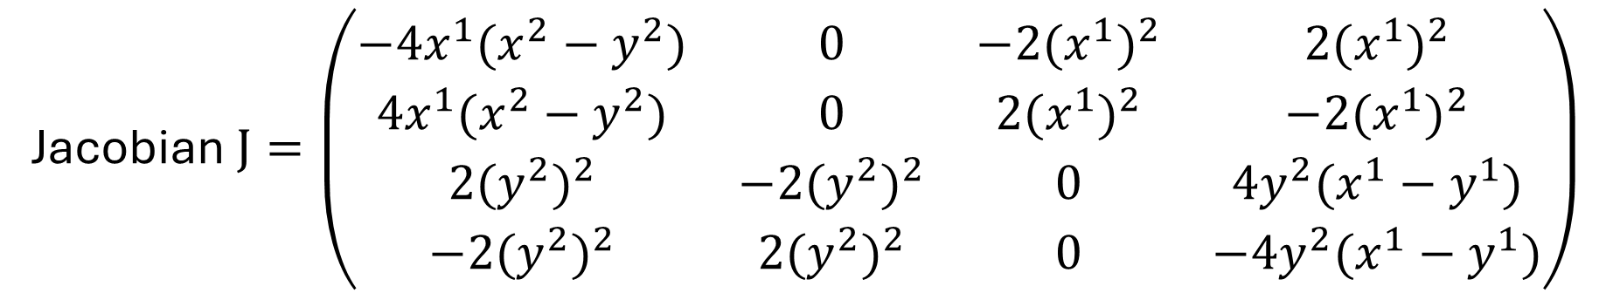


Jacobian in Following Scenario:
$x^{1}>y^{1}$and $x^{2}>y^{2}$
$$\dot{x^{1}}=−2{(x^{1})}^{2}(x^{2}−y^{2})$$
$$\dot{x^{2}}=2{(y^{2})}^{2}(x^{1}−y^{1})$$
$$\dot{y^{1}}={2(x^{1})}^{2}(x^{2}−y^{2})$$
$$\dot{y^{2}}=−{2(y^{2})}^{2}(x^{1}−y^{1})$$
Jacobian $J=\left(\begin{matrix}{−4x}^{1}(x^{2}−y^{2}) & 0 & −2{(x^{1})}^{2} & 2{(x^{1})}^{2} \\ {4x}^{1}(x^{2}−y^{2}) & 0 & 2{(x^{1})}^{2} & −2{(x^{1})}^{2} \\ 2{(y^{2})}^{2} & −2{(y^{2})}^{2} & 0 & {4y}^{2}(x^{1}−y^{1}) \\ −2{(y^{2})}^{2} & 2{(y^{2})}^{2} & 0 & {−4y}^{2}(x^{1}−y^{1})\end{matrix}\right)$
Eigenvalues

Slide 37




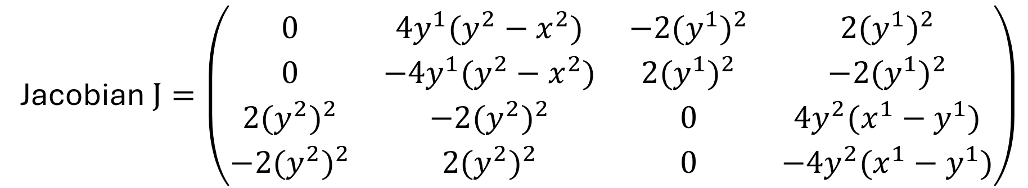
Jacobian in Following Scenario:
$x^{1}>y^{1}$and $x^{2}<y^{2}$
$$\dot{x^{1}}=2{(y^{1})}^{2}(y^{2}−x^{2})$$
$$\dot{x^{2}}=2{(y^{2})}^{2}(x^{1}−y^{1})$$
$$\dot{y^{1}}=−{2(y^{1})}^{2}(y^{2}−x^{2})$$
$$\dot{y^{2}}=−{2(y^{2})}^{2}(x^{1}−y^{1})$$
Jacobian $J=\left(\begin{matrix}0 & {4y}^{1}(y^{2}−x^{2}) & −2{(y^{1})}^{2} & 2{(y^{1})}^{2} \\ 0 & {−4y}^{1}(y^{2}−x^{2}) & 2{(y^{1})}^{2} & −2{(y^{1})}^{2} \\ 2{(y^{2})}^{2} & −2{(y^{2})}^{2} & 0 & {4y}^{2}(x^{1}−y^{1}) \\ −2{(y^{2})}^{2} & 2{(y^{2})}^{2} & 0 & −{4y}^{2}(x^{1}−y^{1})\end{matrix}\right)$
Eigenvalues

Slide 38



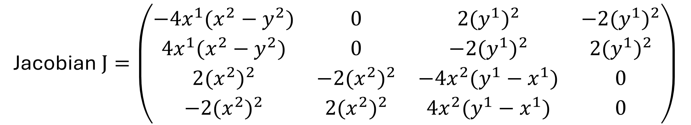


Jacobian in Following Scenario:
$x^{1}<y^{1}$and $x^{2}>y^{2}$
$$\dot{x^{1}}=−2{(x^{1})}^{2}(x^{2}−y^{2})$$
$$\dot{x^{2}}=−2{(x^{2})}^{2}(y^{1}−x^{1})$$
$$\dot{y^{1}}={2(x^{1})}^{2}(x^{2}−y^{2})$$
$$\dot{y^{2}}={2(x^{2})}^{2}(y^{1}−x^{1})$$
Jacobian $J=\left(\begin{matrix}{−4x}^{1}(x^{2}−y^{2}) & 0 & 2{(y^{1})}^{2} & −2{(y^{1})}^{2} \\ {4x}^{1}(x^{2}−y^{2}) & 0 & −2{(y^{1})}^{2} & 2{(y^{1})}^{2} \\ 2{(x^{2})}^{2} & −2{(x^{2})}^{2} & {−4x}^{2}(y^{1}−x^{1}) & 0 \\ −2{(x^{2})}^{2} & 2{(x^{2})}^{2} & {4x}^{2}(y^{1}−x^{1}) & 0\end{matrix}\right)$
Eigenvalues

Slide 39


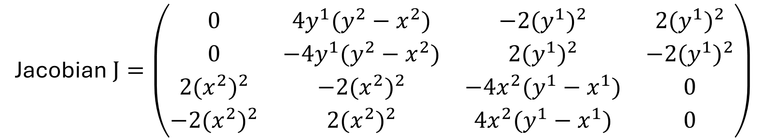
Jacobian in Following Scenario:
$x^{1}<y^{1}$and $x^{2}<y^{2}$
$$\dot{x^{1}}=2{(y^{1})}^{2}(y^{2}−x^{2})$$
$$\dot{x^{2}}=−2{(x^{2})}^{2}(y^{1}−x^{1})$$
$$\dot{y^{1}}={−2(y^{1})}^{2}(y^{2}−x^{2})$$
$$\dot{y^{2}}={2(x^{2})}^{2}(y^{1}−x^{1})$$
Jacobian $J=\left(\begin{matrix}0 & {4y}^{1}(y^{2}−x^{2}) & −2{(y^{1})}^{2} & 2{(y^{1})}^{2} \\ 0 & {−4y}^{1}(y^{2}−x^{2}) & 2{(y^{1})}^{2} & −2{(y^{1})}^{2} \\ 2{(x^{2})}^{2} & −2{(x^{2})}^{2} & {−4x}^{2}(y^{1}−x^{1}) & 0 \\ −2{(x^{2})}^{2} & 2{(x^{2})}^{2} & {4x}^{2}(y^{1}−x^{1}) & 0\end{matrix}\right)$
Eigenvalues

Slide 40
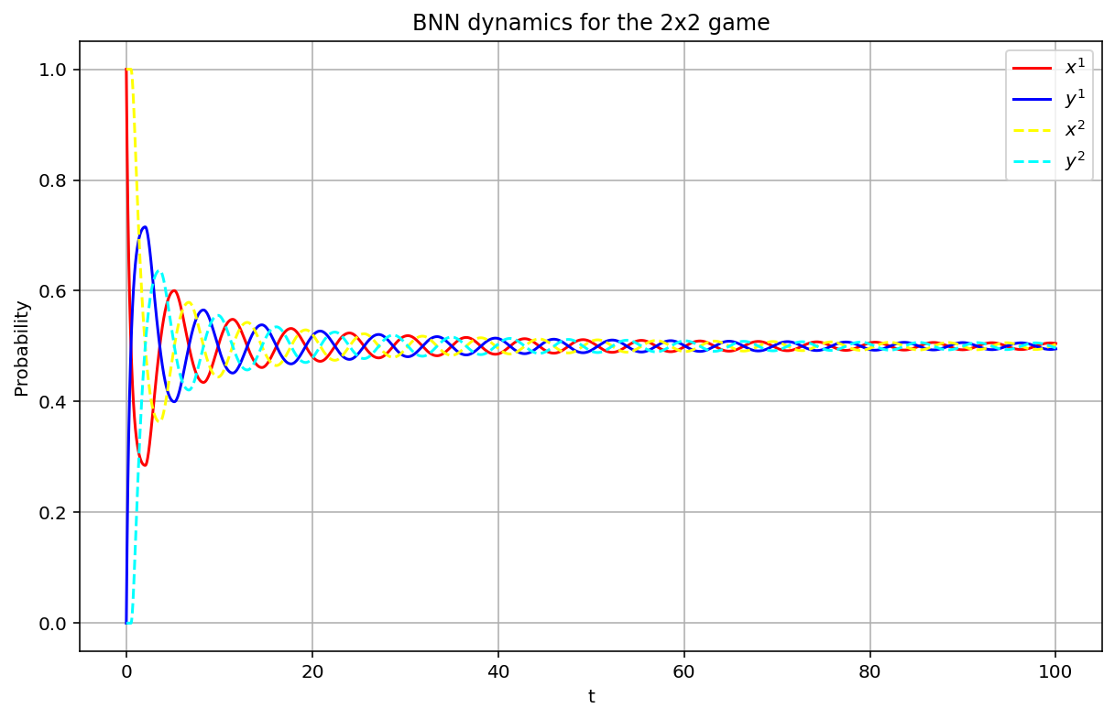

Numerical Results
RK4 Method
Starting Conditions:
$$x^{1}=1, x^{2}=1$$
$$h= .01$$

Slide 41

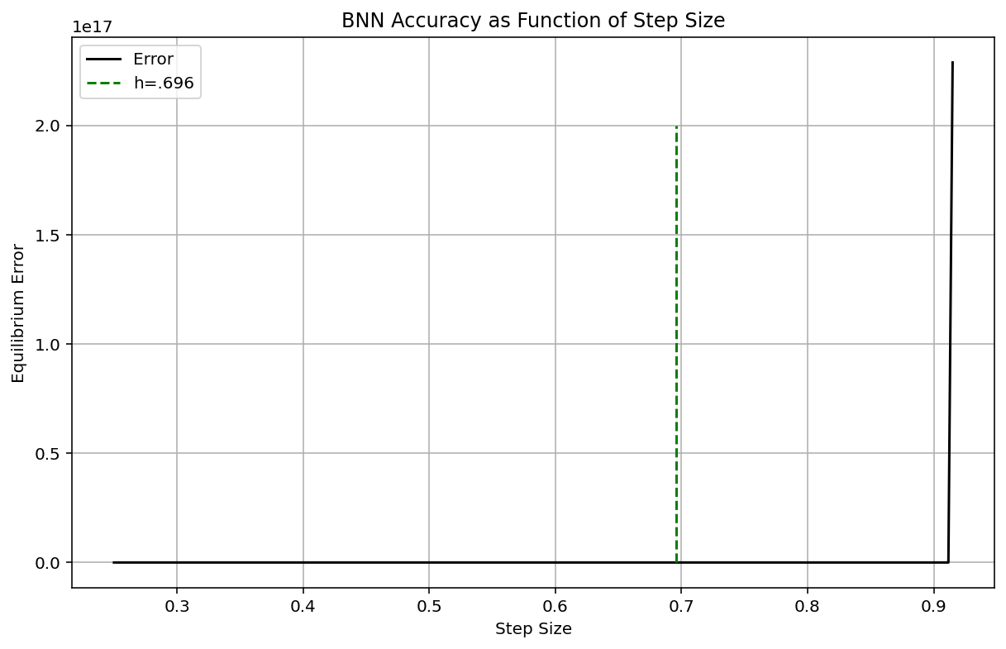

Numerical Results
Effects of Strict Dominance
Two Strictly Dominant Strategies
No Strictly Dominant Strategies
RK4 Method
Starting Conditions:
$$x^{1}=1, { x}^{2}=1$$

Slide 42
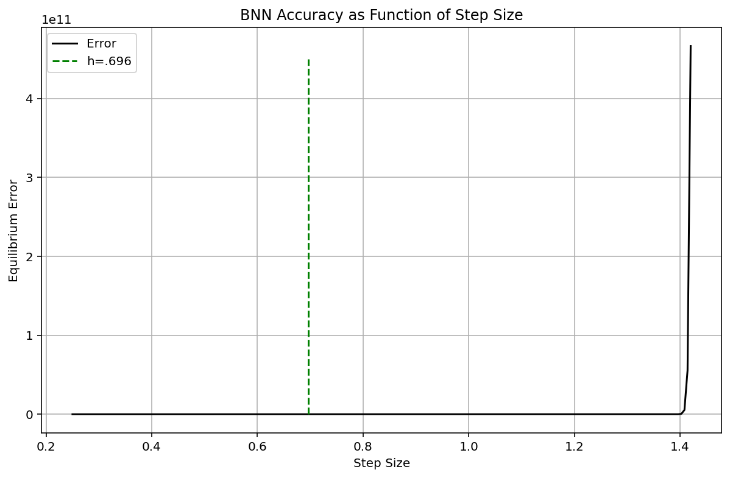
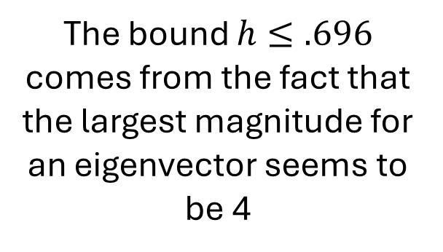
Numerical Results
RK4 Method
Starting Conditions:
$$x^{1}=1, x^{2}=1$$
The bound $h≤.696$ comes from the fact that the largest magnitude for an eigenvector seems to be 4
I need to investigate the eigenvalues further

